Slide 1
Field situation of V. velutina in France
Apimondia Webinar on Invasive species - March 26th
FNOSAD-LSA – Alain Goulnik

Slide 2
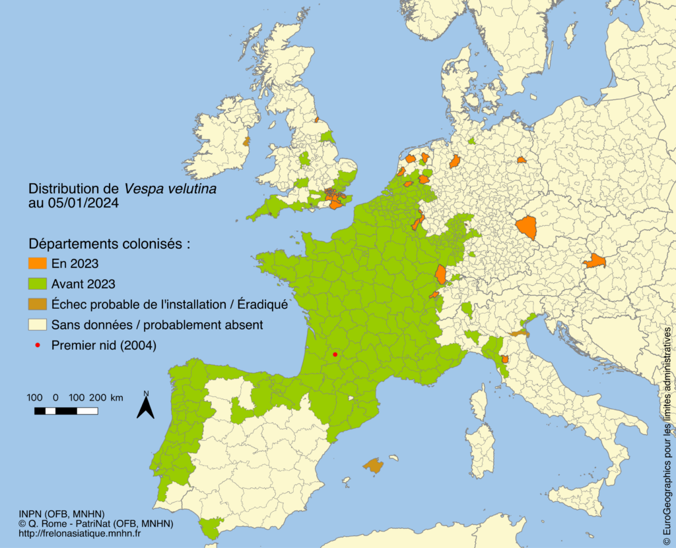
Vespa velutina nigrithorax (Vv) in France: An unstoppable progression
Was introduced in the south-west of the country in 2004
Seen in the center of France around 2014
Most of mainland France covered end of 2023
Authorities were caught off guard, anyway Vv management was and still is under sector responsibility
No eradication plans were prepared
Each region had to make do with their own knowledge and creativity - they improvised field techniques
Vespa velutina’s distribution – from Quentin Rome, MNHN

Slide 3
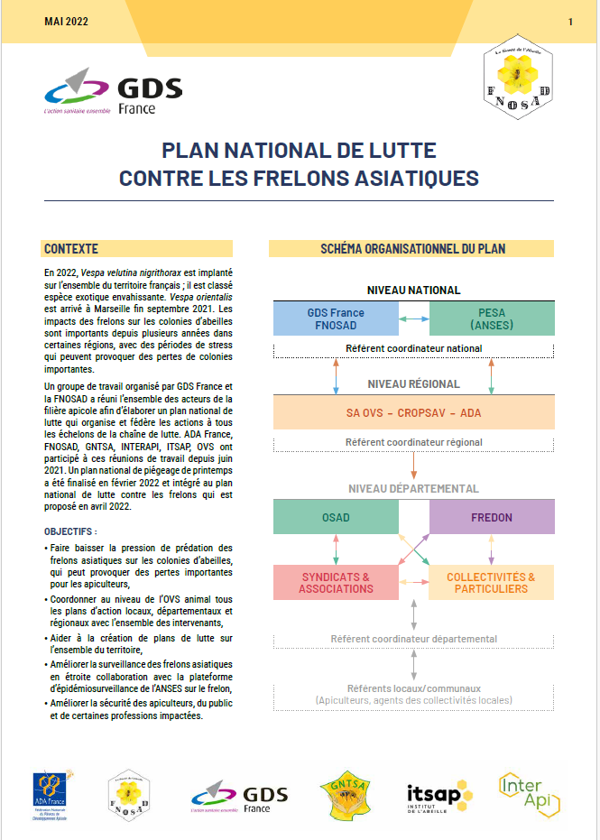
2022: most of the national bee health associations built a plan in order to provide good practices in Vv management. June 2022: first version of the plan was released. Some frustration on beekeepers' side as results were not fully there. February 2024: more institutional actors are involved, a refreshed and more practical version of the plan is made available. As of today, deployment is ongoing.
Source: Etienne Calais

Slide 4
We can’t eradicate Vv, let’s try to mitigate consequences
main concerns addressed
Major colony health issue
Biodiversity, including honeybees
Protecting people

Slide 5
How can we mitigate consequences ?
Destroying nests
Large scale spring queen trapping
Mechanically reducing beehive stress
Protecting people
Protection of biodiversity
Protecting apiaries

Slide 6
first, evaluate risks
Hornet visible population | Nests detection and destruction | Spring queen trapping | Colony stress reduction
Very low, 1 hornet around each hive | +++ | no | No need
Low, 2 to 3 | +++ | no | Needed
Average, 2 to 3 permanent | Best effort | yes | Needed
High, above 4 per hive | Mandatory only when people can be in danger: near school, public parks and so on | yes | Needed

Slide 7
Overall calendar
J | F | M | A | M | J | J | A | S | O | N | D
Spring queen trapping
Stress reduction
Detection and destruction
Worker trapping

Slide 8
Axis 1: Spring queen trapping
J | F | M | A | M | J | J | A | S | O | N | D
Spring queen trapping
Continuous period of no more then 2 months, to be adapted due to difference between north and south of France
To be started depending on weather: A few days above 12°C are recommended before trapping
To be done every year, at least 4 consecutive years
Good results were observed after a few years in “Maine et Loire” area

Slide 9
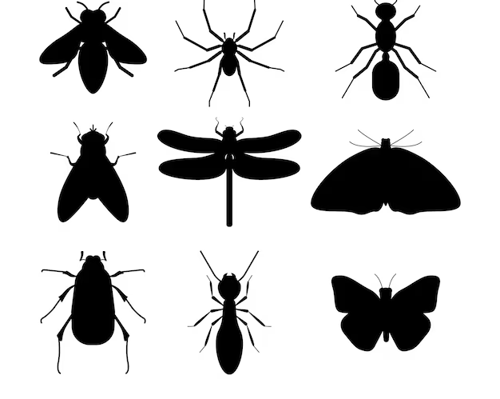
Drawbacks and concerns
There is no perfectly selective or even efficient traps to catch Vv
→ Hence the need to respect instructions: when, where and what kind of trap & bait to use.

Slide 10
Examples of traps
So called « Japanese trap »
So called « Korean trap »
Home made trap
Recommendations
Use “Cone trap” only
Must separate baits and catch cage
Hornet bottle traps are to be prohibited
Meshing depends on localization and infestation level
Consider costs as well
Collecting and storing data is useful to measure effect of trapping

Slide 11
Axis 2: Nest destruction - recommendations
Primary nests – May-June, usually attached to the roofs of sheds / outbuilding
Secondary nests – July-October, mostly at the top of trees but can be found underground
The plan provides guidance for destruction:
Destruction must be carried out by pest technicians
Allowed technics and biocides (e.g. pyrethrins )
Technicians good practices (e.g. management of nests after treatments)
Storing data is as well useful to follow the effect of trapping
No need to destroy nests in winter

Slide 12
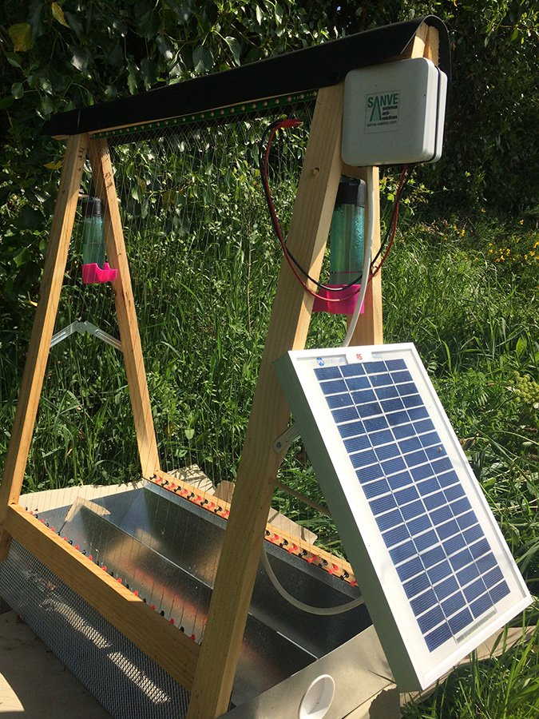
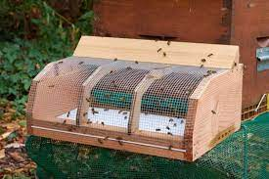
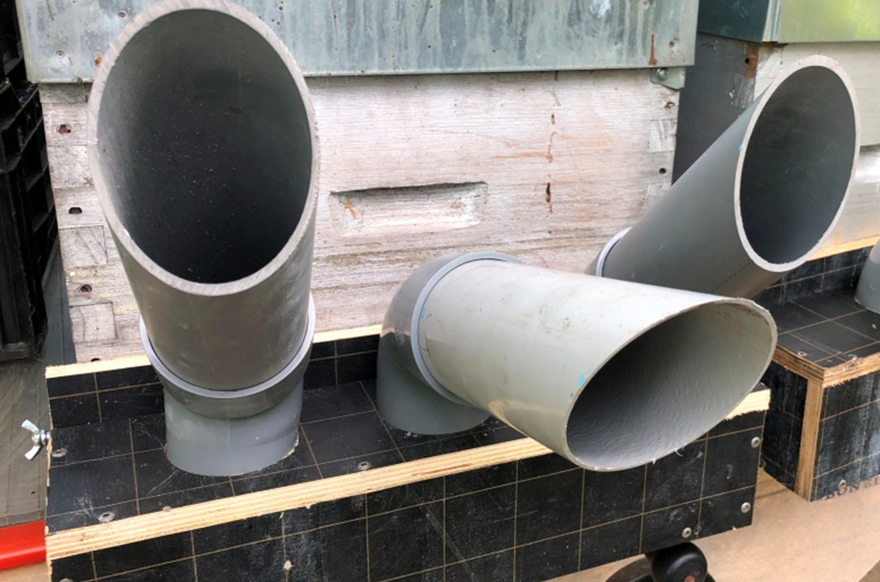
Axis 3: Apiary and colony protection
Creativity is key and the plan provide various technics, used generally together. The goal here is to reduce colony stress, not predation.
Anti hornet muzzles and/or nets
Electric harps
Entrance reducer (pipes or classical reducers)
Note that here as well costs are to be considered, particularly for professional beekeepers

Slide 13
Governance – a top-down approach
Continuous improvement
National steering committee
WG
Communicate
& Train
Working group including most of the stakeholders
Annual assessment:
What went well / What went bad
Regional steering committee
Local steering committee
Providing data to upper level
Trapping
Destruction
Communication, training
Targets: Beekeepers, pest technicians, citizens, communities, local authorities.

Slide 14
Conclusion
This plan provides a pragmatic approach to fight & control Vv
Based on techniques that are not news but that needed to be circulated (see for instance 2017, Turchi L, Derijard B. Options for the biological and physical control of Vespa velutina nigrithorax)
Even if it comes late, it brings some useful advice and guidance to reduce stress on apiaries
The plan comes also with data collection and analysis to measure its effects
It is also designed to be improved over the years
Funding is shared between beekeeping sector and public funds
Nest detection is still the weak spot of this plan
Even if not perfect, this plan will help us to live with the yellow leg hornet

Slide 15
Any questions ?
fnosad.lsa@gmail.com
alain.goulnik@fnosad.fr

